Slide 1
Spring Cloud: Simplifying Distributed Systems

Slide 2
Agenda
What is Spring Cloud?
Key Components
Benefits
Use Cases
Demo

Slide 3
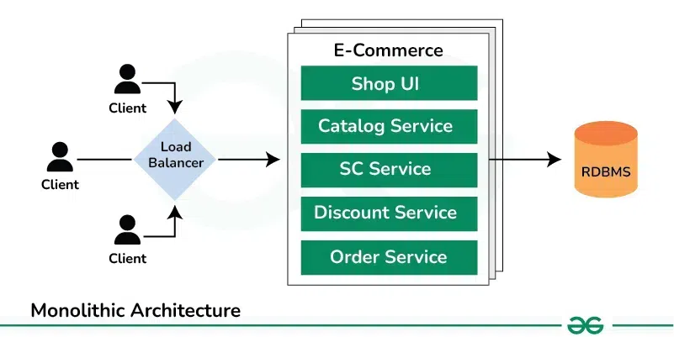
Monolithic architecture

Slide 4
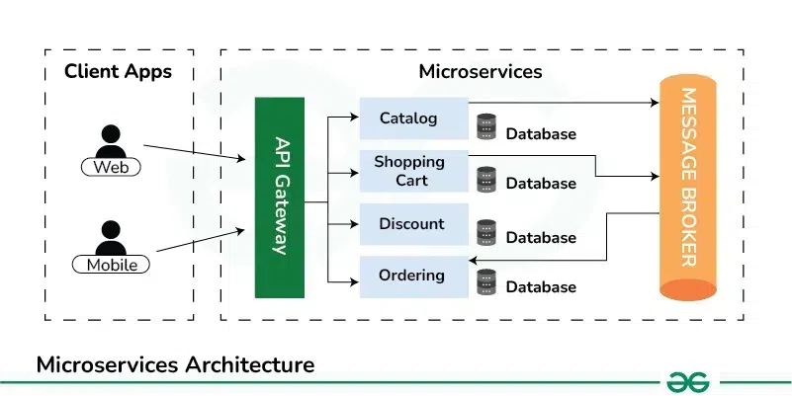
Microservice architecture

Slide 5
What is Spring Cloud?
Spring Cloud is an open-source framework that provides tools for developers to build applications for the cloud.
Framework for building robust cloud applications
Built on top of Spring Boot
Provides tools for common distributed system patterns

Slide 6
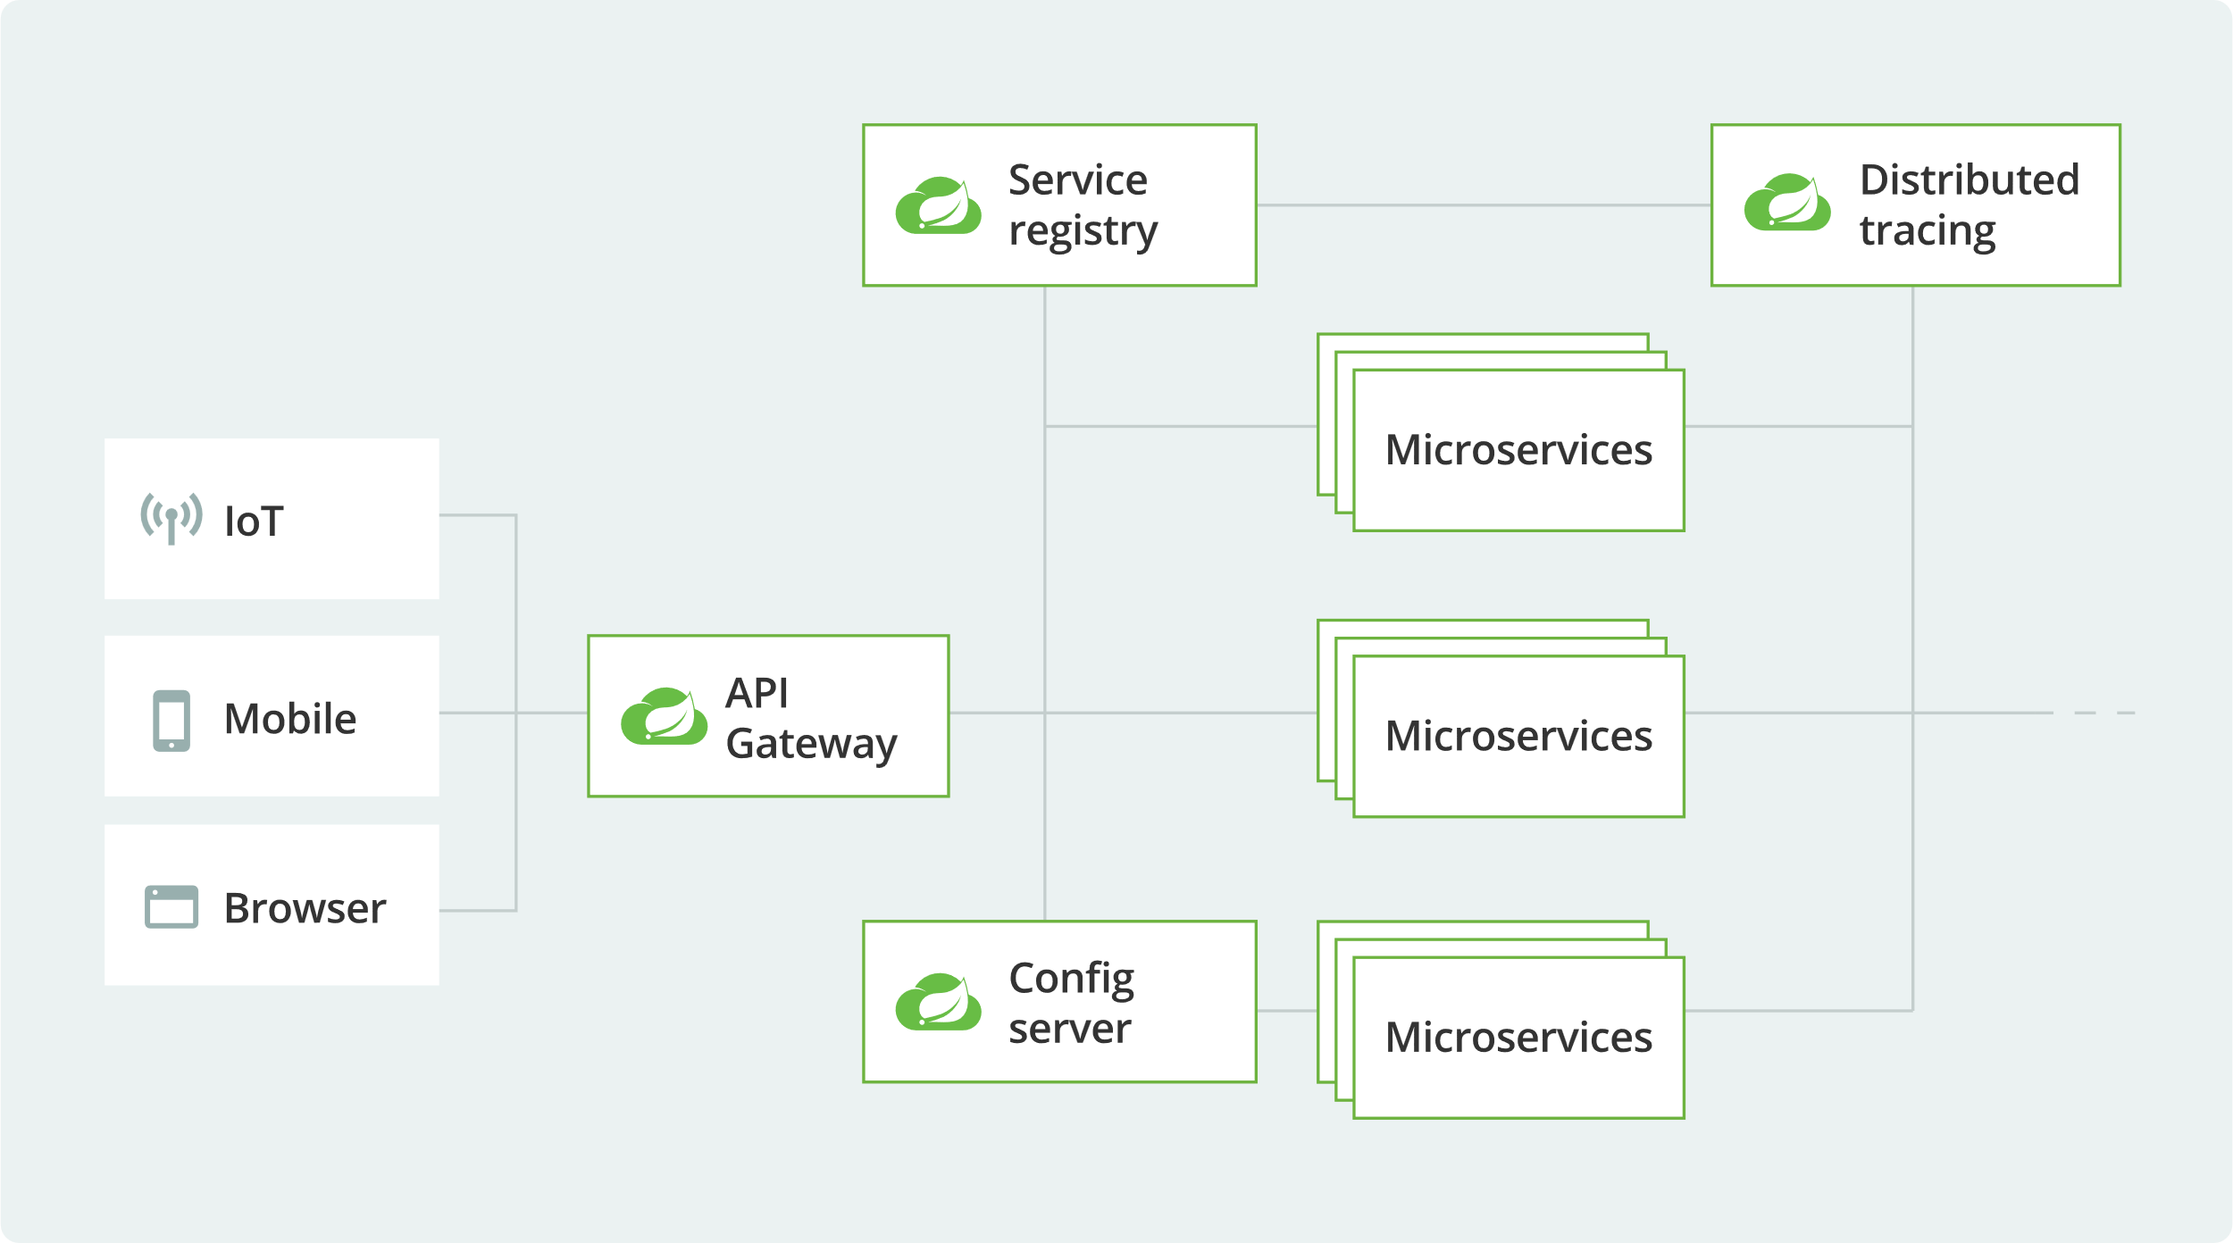
Spring Cloud Architecture highlights

Slide 7
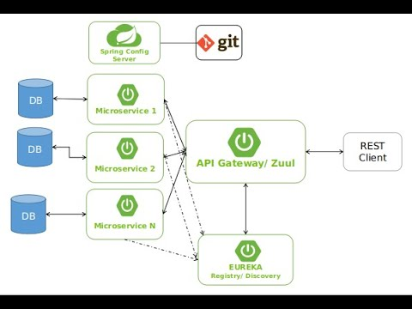
Spring Cloud Architecture highlights

Slide 8

2. Key Components
Spring Cloud Config
Spring Cloud Netflix
Spring Cloud Stream
Spring Cloud Security
Spring Cloud Sleuth

Slide 9
Spring Cloud Config
Centralized configuration: A single location to manage configuration for all applications and environments
Live configuration updates: Microservices can be refreshed without redeploying the service
Audit history: A full history of configuration changes is available in one place
Git repository support: The default server storage backend uses git, which provides labeled versions of configuration environments
Encrypted values: Encrypted values can be generated using a REST call
Configuration mapping: Configuration resources map directly to Spring Environment

Slide 10
Spring Cloud Netflix
Spring Cloud Netflix is a set of Netflix OSS integrations for Spring Boot applications that enables developers to build distributed systems:
Netflix Eureka
A REST-based service that helps locate services for load balancing and failover.
Some alternatives because the Eureka2.0 is the last version and the development is stopped.
Apache Zookeepar
HashiCorp Consul

Slide 11
Spring Cloud Netflix
Netflix Hystrix
A library that helps isolate access points to remote systems and services and stop cascading failures.
Some alternatives to Hystrix include:
Resilience4j: An open-source option for Spring developers to implement the circuit breaker pattern. It also includes other features like Rate Limiter, Retry, and Bulkhead. To migrate from Hystrix to Resilience4j, you can replace the Hystrix dependency with the Resilience4j dependency in your project and refactor your code to use the Resilience4j API.
Sentinel: Another open-source alternative to Hystrix.

Slide 12
Spring Cloud Netflix
Netflix Zuul
An edge service that provides dynamic routing, monitoring, resiliency, and security
Alternatives:
Spring Cloud Gateway is a new module in the Spring Cloud family that is dedicated to being an API gateway in a microservices-based architecture

Slide 13
Spring Cloud Netflix
Spring Cloud Netflix allows developers to quickly configure and enable common patterns in their applications using annotations. It can help developers build robust, resilient, and collaborative systems.
Here are some features of Spring Cloud Netflix:
Eureka health checks: Allows developers to propagate application status to Eureka, so that other applications don't send traffic to applications that are not in the "UP" state
Hystrix Dashboard: Displays the health of each circuit breaker
Service discovery: A dynamic service discovery mechanism that uses a service discovery agent to maintain a service registry

Slide 14
Spring Cloud Stream
Spring Cloud Stream is a framework for building microservices that are event-driven and connected to shared messaging systems. It's built on top of Spring Boot and works with Spring MVC or Spring WebFlux.
Spring Cloud Stream supports a variety of binder implementations, including:
RabbitMQ, Apache Kafka, Kafka Streams, Apache Pulsar, Amazon Kinesis, Google PubSub, Solace PubSub+, Azure Event Hubs, Azure Service Bus, and AWS SQS.
Spring Cloud Stream uses Spring Integration to provide connectivity to message brokers. It also provides opinionated configuration of middleware from several vendors.

Slide 15
Spring Cloud Security
OAuth2/JWT support
Single Sign-On
Token relay

Slide 16
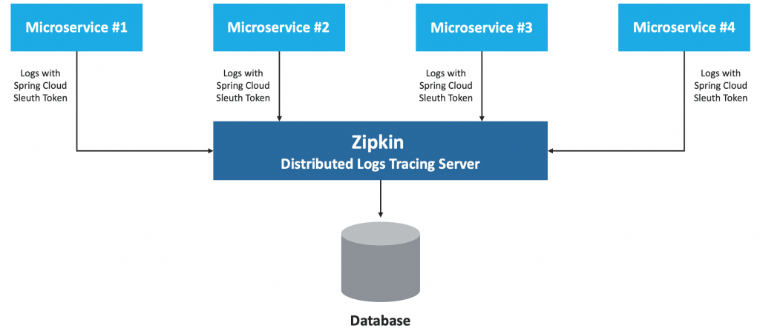
Spring Cloud Sleuth
Spring Cloud Sleuth is a project that automatically configures distributed tracing for Spring Boot applications. It helps to track the flow of requests across different services by adding trace and span IDs to log entries
Integration with Zipkin

Slide 17
3. Benefits of Spring Cloud
Spring Cloud focuses on providing good out of box experience for typical use cases and extensibility mechanism to cover others.
Distributed/versioned configuration
Service registration and discovery
Routing
Service-to-service calls
Load balancing
Circuit Breakers
Distributed messaging
Short lived microservices (tasks)
Consumer-driven and producer-driven contract testing

Slide 18
4. Spring Cloud Use Cases
Microservices architectures
Cloud-native applications
API gateways
Event-driven systems

Slide 19
5. Demo
https://github.com/ryanjbaxter/beginners-guide-to-spring-cloud

Slide 20
Thank you

